Slide 1

Chandigarh University
Department of Mathematics
B.Tech. CSE (Core/DS/IT/CC)
Semester-3
Subject Code:25MTT-202
Discrete Mathematics
Chapter:1.2.1
Dr. SARTAJ
DISCOVER . LEARN . EMPOWER

Slide 2

CO mappings

Slide 3

CO-PO mappings
Note: Degree of relevance/correlation: 1-Low, 2-Medium, 3-High, Blank or ‘- ‘- Nil

Slide 4
Topics Covered
CNF (Conjunctive Normal Form)
DNF (Disjunctive Normal Form)
Rules of Inference
Conclusions
Video links
References

Slide 5
Normal Forms
Normal Forms are structured representations of logical expressions where the formula is broken down into a combination of literals (variables or their negations) connected by logical operators such as AND, OR, and NOT.
These forms help in the simplification and standardization of logical statements.
Key Concepts:
Literal: A variable or its negation (e.g., 𝐴 or ¬𝐴).
Clause: A disjunction of literals (e.g., 𝐴 ∨ ¬𝐵).
Normal Form: A logical formula that follows a specific structure, such as CNF or DNF.

Slide 6
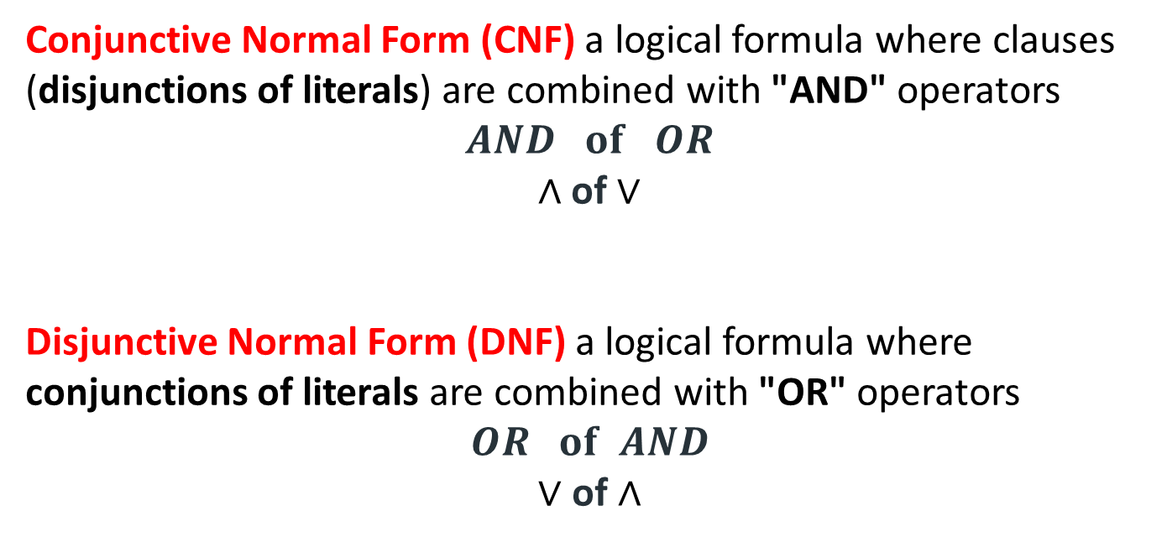
Types of Normal Form
Conjunctive Normal Form (CNF) a logical formula where clauses (disjunctions of literals) are combined with "AND" operators
$$AND of OR$$
$\text{∧}$ of ∨
Disjunctive Normal Form (DNF) a logical formula where conjunctions of literals are combined with "OR" operators
$$OR of AND$$
∨ of $\text{∧}$

Slide 7
Properties of Normal Form
Every truth table (Boolean function) can be written as either a conjunctive normal form (CNF) or disjunctive normal form (DNF).
Every propositional formula can be transformed into DNF by considering the truth assignments where it is true.
Every propositional formula can be transformed into CNF by considering the truth assignments where it is false and negating them.

Slide 8
Rules of Inference
Argument : By an argument, we mean a sequence of statements that end with a conclusion.
By valid argument, we mean that the conclusion, or final statement of the argument, must follow from the truth of the preceding statements (or premises) of the argument.
An argument is valid if and only if it is impossible for all the premises to be true and the conclusion to be false.
Rules of inference are our basic tools for establishing the truth of statements.

Slide 9
Rules of Inference
How argument looks like: Consider the following argument involving propositions:
Argument | Translation
Premise 1: “If you have a current password, then you can log onto the network.” Premise 2: “You have a current password.” Therefore, Conclusion: “You can log onto the network.” | p: “You have a current password” q: “You can log onto the network.” Then, the argument has the form p → q p ∴ q where ∴ is the symbol that denotes “therefore.”

Slide 10
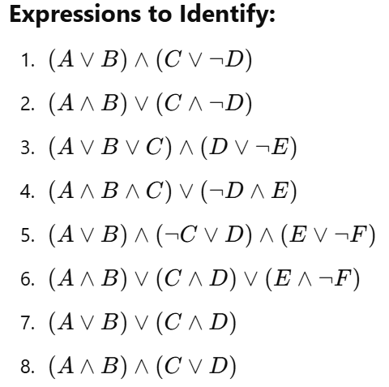
Learning Activity
Identify whether each one is in
CNF (Conjunctive Normal Form)
or
DNF (Disjunctive Normal Form)

Slide 11
Conclusion
Identify Conjunctive Normal Form (CNF) and Disjunctive Normal Form (DNF).
Related applications and problems are discussed.

Slide 12
Video Links
https://www.youtube.com/watch?v=sPQ3ptUMltA&utm_source=chatgpt.com
https://youtu.be/YYQfYBNlfZg?si=bzEHNN2yciHgzZjb

Slide 13
References
Sr. No. | Author | Name of the Book | Publisher | Year of Publication
1 | Kenneth H. Rosen | Discrete Mathematics and Its Applications | McGraw-Hill | 2019
2 | C. L. Liu | Elements of Discrete Mathematics | McGraw-Hill | 1996
3 | J. P. Tremblay, R. Manohar | Discrete Mathematical Structures with Applications to Computer Science | Tata McGraw Hill | 2001
4 | Kolman, Busby, Ross | Discrete Mathematical Structures | PHI | 2001
5 | Narsingh Deo | Graph Theory with Applications to Engineering and | PHI | 2017

Slide 14
Thanks!!!

